Slide 1
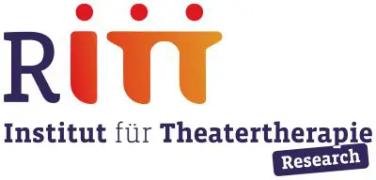

Drama Therapy as a Mental Health Intervention for Women in the Shatila Refugee Camp, Lebanon
Field Report
Sara Sakhi, Dr Lina Haddad Kreidie, Farah Wardani,
HH Sheikha Intisar AlSabah, Karima Anbar

Slide 2
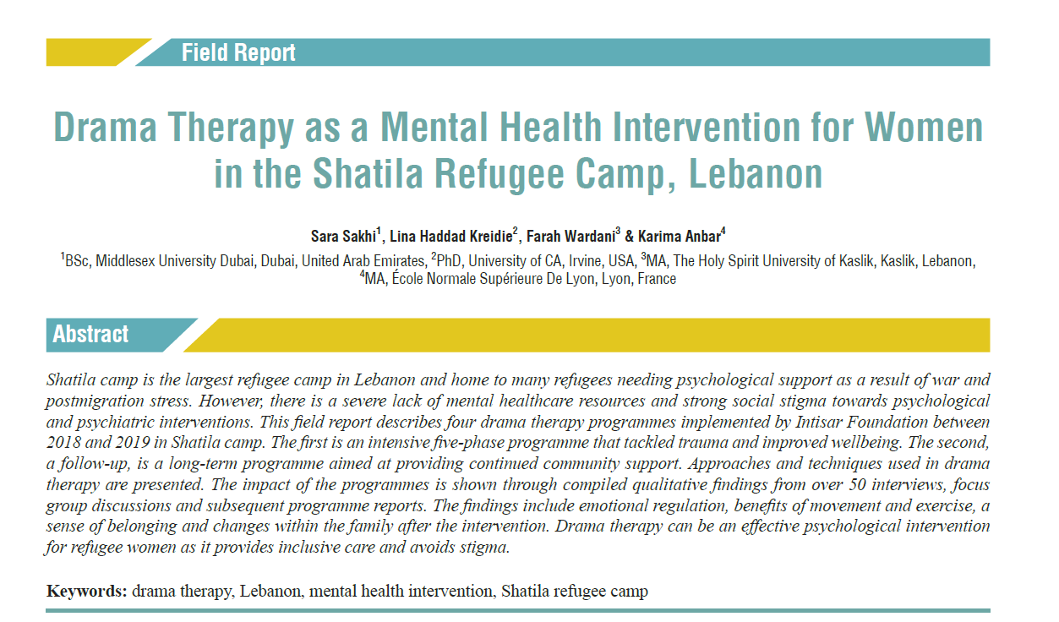

Slide 3
1
Introduction

Slide 4
CONTENTS
Shatila Camp & Refugee mental health
Dramatherapy Programme Overview
Introduction and Background
1
2
3
4
Implementation
5
Research and Key Findings
6
Conclusions

Slide 5
Introduction
Context:
- Shatila Camp is the largest refugee camp in Lebanon.
- Home to Palestinian and Syrian refugees facing harsh living conditions.
- Refugees suffer from psychological stress due to war and postmigration issues.
Problem:
- Lack of mental healthcare resources and strong social stigma towards psychological interventions.

Slide 6
Background
Palestinian Refugees:
- Protracted refugee status, low socioeconomic status, restricted employment opportunities.
- Limited access to education and healthcare.
Syrian Refugees:
- Strained resources due to 2011 Syrian war.
- Economic challenges and social discrimination.
- Legal hurdles for residence and work.

Slide 7
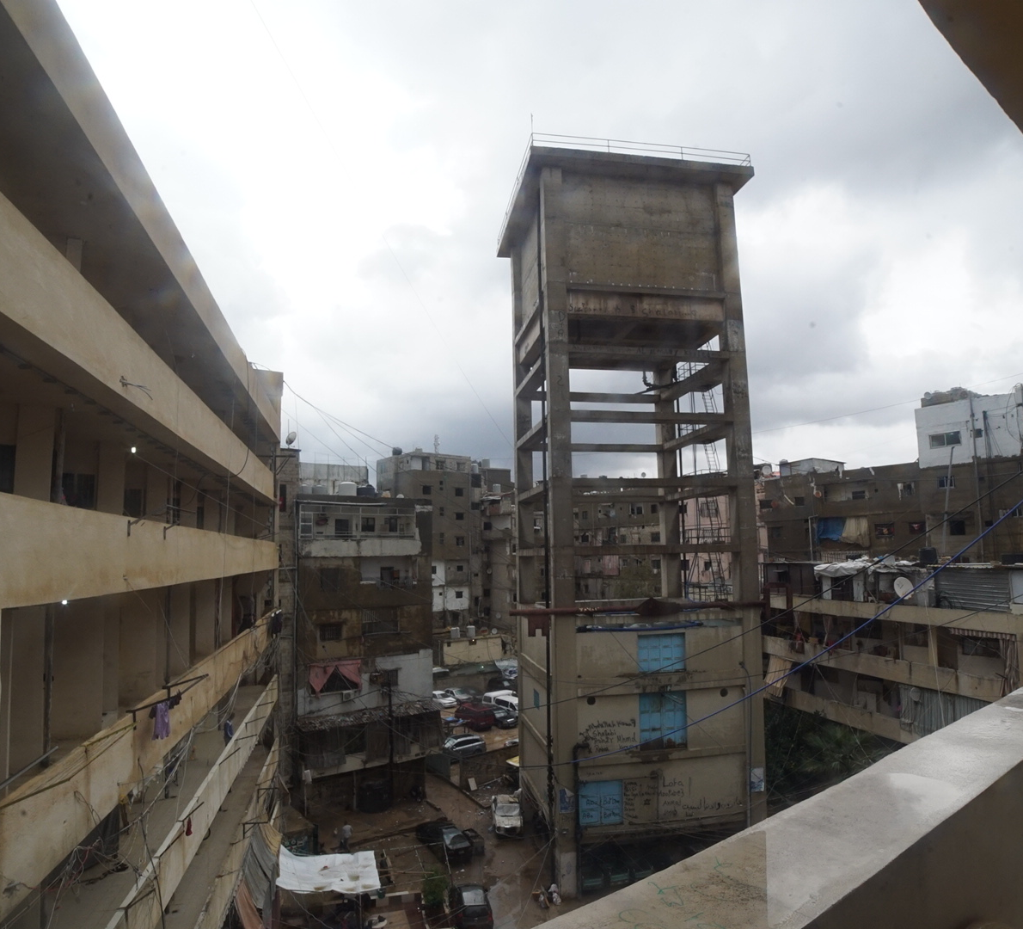
2. Shatila Refugee Camp and Refugee Mental Health

Slide 8
Shatila Camp Conditions
Living Conditions:
- Overcrowded and inadequate housing.
- Historical violence (e.g., Sabra and Shatila massacre).
- Lack of governmental authority and safety.

Slide 9
Mental Health Challenges
- Pre- and post-migration trauma, generational trauma
- High levels of mental disorders among refugees.
- Limited access to specialized mental health care.
- Stigma and financial barriers to seeking help.

Slide 10
3
Programme Overview

Slide 11
Drama Therapy Overview
- HH Sheikha Intisar AlSabah founded Intisar Foundation in an effort to address the unmet mental health needs for women affected by war and trauma in the Arab world
Intisar Foundation started its field operations in 2018 after extensive mapping and research which led to dramatherapy being used as the main modality.
Group-based (community focused)
Little to no stigma, culturally sensitive
Holistic in its approach (use of body, voice, and movement in addition to emotional and cognitive work)

Slide 12
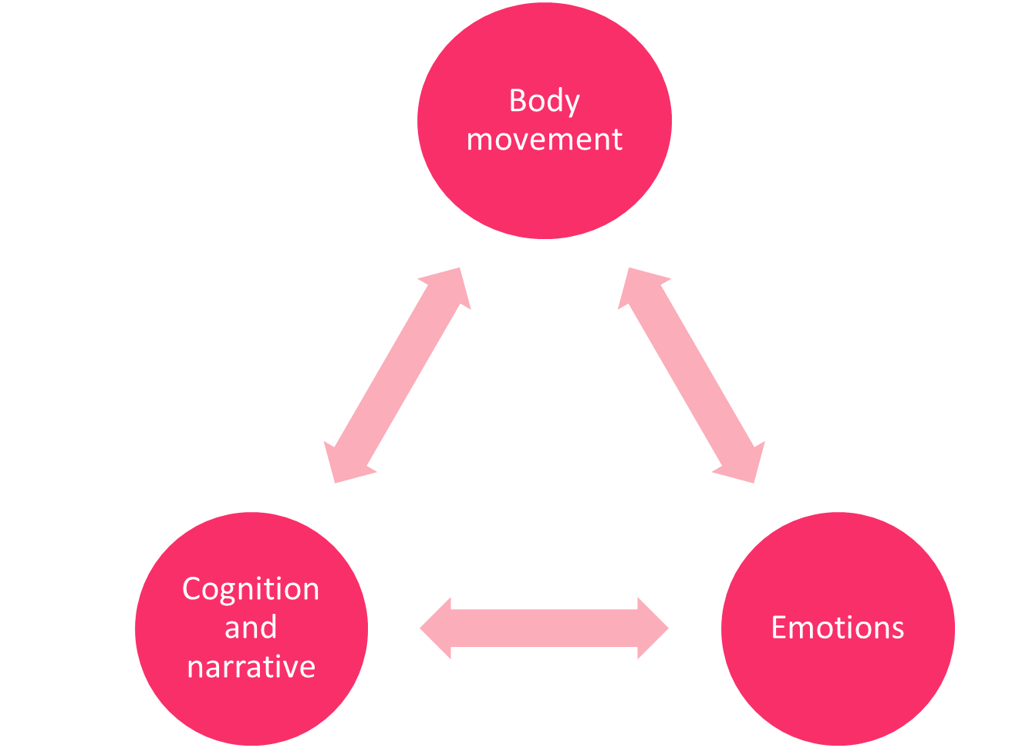
Notes:
Dramatherapy is a holistic approach that takes into account and utilises all three facets, providing an active engagement with the body, cognition and emptions. We focus a lot on the body, as somatic symptoms and physically held manifestations of trauma are often ignored. Movement, embodiment and physical expression play a large role in drama therapy.
Cognition and narratives are playfully approached through theatre activities that provide a safe distance for discussion and engaging with uncomfortable themes relating to trauma.
Finally, emotional processing and expression take “centre stage” in dramatherapy as ultimately all programmes aim to provide a safe space for expression, grieving and celebrating

Slide 13
4
Implementation

Slide 14
Drama Therapy Program in Shatila
Implementation:
- Conducted by Intisar Foundation between 2018 and 2019.
Included intensive (12 weekly sessions) and follow-up programs (12 monthly sessions).
Held within the camp in community centers, trusted NGOs
After agreements were established with partners, the social workers would conduct outreach and create groups

Slide 15
Phase 1: Dramatic Play
Rapport building, trust, personal disclosure.
Phase 2: Scene Work
Theatre techniques, self-exploration, relaxation.
Phase 3:
Role Play
Imagination, group solidarity, guided meditation.
Phase 4: Culminating Enactments
Personal insight, memory recollection, open expression.
Phase 5: Dramatic Ritual
Public or private performance, collection of Vignettes or a session that focuses on closure, celebrating accomplish-ments.
Five-Phase Model by Rene Emunah, 1994
Notes:
:

Slide 16
5
Research and Key Findings

Slide 17
Phase 1: Pre-Programme Interviews
Obtained list Of Participants And Arranged Individual Interviews
Collected Demographic Data And Group Profile Information
Obtained Informed Consent And Ensured Anonymity
Translated And Transcribed Interviews
Phase 2: Focus Group Discussion
Conducted halfway through the programme
Discussed programme experiences and possible improvements
Audio-recorded, translated, and transcribed discussion
Notes:
And this would help us write a brief report where we would describe the group that might help the

Slide 18
Phase 3: Post-Programme Interviews
Conducted within 2 weeks after the final sessions
Open-ended questions to explore the programme's impact
Ensured consent, anonymity, and audio-recording
Translated and transcribed interviews
Phase 4: Analysis of Findings
Utilized interpretative phenomenological analysis
Coded and refined transcripts to find common themes
Clustered codes into themes and superordinate themes

Slide 19
Findings
Emotional Regulation
Benefits of Movement and Exercise
A Sense of Belonging
Changes within the Family

Slide 20
Emotional Regulation
Our upbringing was very conservative and we were taught that showing emotions is not okay. We had to keep everything buried inside us. It is shameful to cry, it is shameful to complain, it is shameful to confide in anyone because they will turn around and mock us. That made me very paranoid about people's intentions. So, I always avoided talking about my feelings or my problems. But the sessions here taught me that it is okay to be expressive. I can and should talk to my friends and my colleagues about what is bothering me.

Slide 21
Benefits of Movement and Exercise
When we first started the sessions, I was stiff, I could not move easily. But when I let my mind wander with the music, it felt like I was flying’.

Slide 22
A Sense of Belonging
Frankly, I do not have many friends. I always felt that I bring people down because I constantly felt depressed. As the sessions went on, I found myself more comfortable with the women around me because they were open, and this helped me become more open. We were able to talk without fear or restrictions, we were in a sacred place together. Usually, we would whisper our secrets, but not in the sessions.

Slide 23
Changes within the Family
“My daughters used to be scared of me. I used to yell at them and beat them over the smallest thing, it was living in a constant state of stress that made me so irritable. The drama therapy sessions were a chance to expel all the negative energy and come home feeling light. This allowed me to be more understanding with my daughters, as I realised that violence would make them hate me and less responsive to me. Many things have changed, we do not yell anymore, the girls finish their homework quicker and help me around the house without causing a fuss.

Slide 24
6
Conclusion

Slide 25
Limitations
strengthens
The results do not offer a statistical analysis of the program's impact but rely solely on personal narratives and experiences.
Despite using standardized questions to reduce bias, both researcher and participant biases may still be present.
Some participants might have withheld negative feedback due to friendliness or social desirability biases.
The study offered insights from a non-Western perspective
The study showed the malleability and flexibility of non-traditional approaches to mental health and highlighted the possibilities for future endeavours in poverty-stricken and low-resource contexts
The approach of DT proved to align with the needs of the population, beyond pathologization

